Slide 2
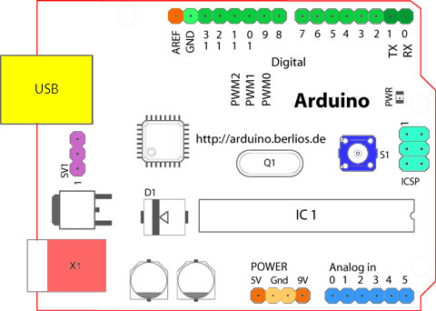

Slide 3
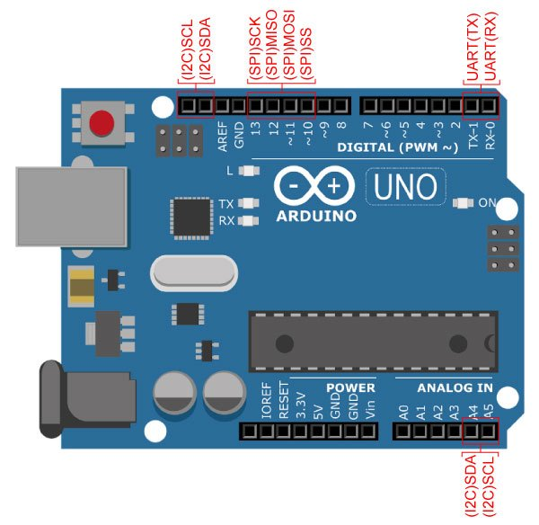

Slide 4
USART in Arduino Uno
USART (Universal Serial Asynchronous Receiver Transmitter) is a serial communication protocol used to transmit/receive data serially at a specific baud rate.
Several devices such as GPS, GSM, RFID, sensors, etc need to communicate with the microcontroller for transmitting or receiving information. To communicate with the microcontroller, several communication protocols are used such as RS232, SPI, I2C, CAN etc. Basically, a protocol is a set of rules agreed by both, the sender and the receiver, on -
How the data is packed?
How many bits constitute a character?
When the data begins and ends?
With the help of USART, we can send / receive data to a computer or other devices.
USART is also used in interfacing microcontroller with various modules like Wi-Fi (ESP8266), Bluetooth, GPS, GSM, etc.

Slide 5
AsynchronousCommunication: Asynchronous operation means that a process operates independently of other processes.
Asynchronous communication means each character (data byte) is placed in between the start and stop bits. The start bit is always 0 (low) and the stop bit is always 1 (high).

Slide 6
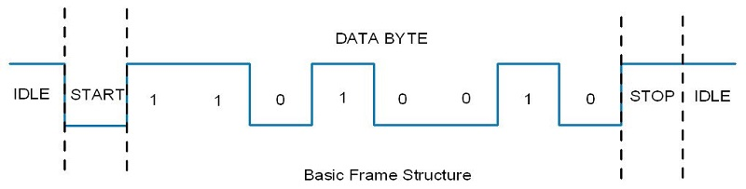

Slide 7
Arduino USART
Arduino Uno (ATmega328) has an in-built USART which is useful for serial communication. It can be used to communicate data between PC or various serial devices like GSM, GPS, Bluetooth, etc.
Arduino communicate with serial devices over digital pins 0 (RXD) and 1 (TXD). Whereas it communicates with PC/laptop over USB.
This peripheral, allows the Arduino to directly communicate with a computer, thanks to the fact that the Arduino has an onboard USB-to-Serial converter.
Therefore, programs written on a Windows, Mac, or Linux OS can be used with an Arduino connected to a USB port as if it was a serial port (serial port communication is trivial compared to USB communication).

Slide 8
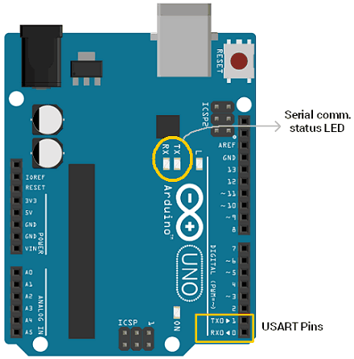

Slide 9
In above image, two led indicators i.e. TX and RX are also highlighted which are status LED used to indicate serial transmission and reception.
When PC transmits data serially to Arduino Uno over USB, RX led glow to indicate data is received. When Arduino Uno transmits data to PC over USB, TX led glow to indicate data is transmitted.
LED status indication acts completely opposite when communicating data between serial module/devices. In case of Arduino Uno, simultaneous serial communication over USB and RX-TX pins are not allowed.
Serial communication occurs between Arduino and computer/serial devices at a same baud rate like 4800, 9600, 115200, 34800, etc.

Slide 10
Arduino Serial Monitor
Arduino IDE has integrated serial monitor which can be used to watch serial data.
After uploading program to the Arduino, open Serial Monitor to watch Serial data.

Slide 11
Functions Used for Serial Communication
Serial.begin (baud rate)
This function is used to initiate the serial communication with baud rate. e.g. Serial.begin(9600)
Serial.print (data, format type (optional))
It sends ASCII character on serial port so human can read it easily. This function converts the data to ascii character and then send (print) it. e.g. Serial.print (123); Serial.print (“123”); Serial.print (12, HEX)
Serial.println (data, format type (optional))
It sends ASCII character on serial port followed by carriage return.
Serial.write()
This function writes binary data to the serial port. It returns number of byte written. e.g. Serial.write (65); // it writes actual byte to serial port
Serial.available ()
This function returns the number of bytes available to read.
Serial.read()
This function is used to read data serially. e.g. received_data = Serial.read()
Serial.readString()
This function is used to read the received string. e.g. String received_data = Serial.readString()

Slide 12
Transmit Data Serially to Computer
void setup()
{
Serial.begin (9600); //initiate serial communication with 9600 baud rate
}
void loop()
{ Serial.println("hello"); //send data to computer
delay(1000);
}

Slide 13
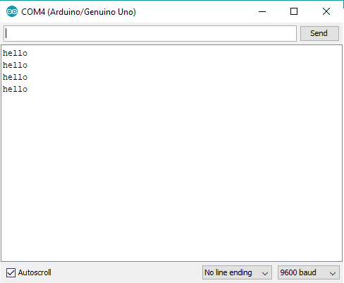

Slide 14
Read data serially from PC and display on Serial Monitor
char received_data; //variable to store read data
void setup()
{
Serial.begin(9600);
}
void loop()
{
if(Serial.available()>0) //check for any data received
{
received_data = Serial.read(); //read received data Serial.print("received data is: "); Serial.println(received_data); //display received data
}
}

Slide 15
Read transmitted String from PC
String receive_buffer;
void setup()
{
Serial.begin(9600);
}
void loop()
{
if(Serial.available()>0) //check for any data received
{
receive_buffer = Serial.readString(); //read received data
Serial.print("received data is: "); Serial.println(receive_buffer); //display received data
}
}

Slide 16
Control LED ON-OFF from PC using Arduino
char received_data;
void setup()
{ Serial.begin(9600);
pinMode(13, OUTPUT);
}
void loop()
{
if(Serial.available()>0)
{ //read serial data
received_data = (char)Serial.read();
Serial.print("received data is: "); //check for received command for action
if(received_data=='1')
{
digitalWrite(13, HIGH);
Serial.println(received_data);
}
else if(received_data=='0')
{ digitalWrite(13, LOW);
Serial.println(received_data);
}
else Serial.println(" invalid");
}
}

Slide 17
Serial Peripheral Interface (SPI)
Serial Peripheral Interface (SPI) is a synchronous serial data protocol used by microcontrollers for communicating with one or more peripheral devices quickly over short distances. It can also be used for communication between two microcontrollers.
With an SPI connection there is always one master device (usually a microcontroller) which controls the peripheral devices. Typically there are three lines common to all the devices:
MISO (Master In Slave Out) - The Slave line for sending data to the master,
MOSI (Master Out Slave In) - The Master line for sending data to the peripherals,
SCK (Serial Clock) - The clock pulses which synchronize data transmission generated by the master
and one line specific for every device:
SS (Slave Select) - the pin on each device that the master can use to enable and disable specific devices.
When a device's Slave Select pin is low, it communicates with the master. When it's high, it ignores the master. This allows you to have multiple SPI devices sharing the same MISO, MOSI, and CLK lines.
SPI: 10 (SS), 11 (MOSI), 12 (MISO), 13 (SCK).
It is, however, possible to use any pin as the Slave Select (SS) for the devices.

Slide 18
To use this library #include <SPI.h>
To write code for a new SPI device you need to note a few things:
What is the maximum SPI speed your device can use? This is controlled by the first parameter in SPISettings. If you are using a chip rated at 15 MHz, use 15000000. Arduino will automatically use the best speed that is equal to or less than the number you use with SPISettings.
Is data shifted in Most Significant Bit (MSB) or Least Significant Bit (LSB) first? This is controlled by second SPISettings parameter, either MSBFIRST or LSBFIRST. Most SPI chips use MSB first data order.
Is the data clock idle when high or low? Are samples on the rising or falling edge of clock pulses? These modes are controlled by the third parameter in SPISettings.

Slide 19
Connecting Multiple Slave Devices
In SPI, a master can communicate with a single or multiple slaves. For applications using multiple slaves, the following configurations are possible:
Independent slaves. This is a most common configuration of the SPI bus. The MOSI, MISO and SCK lines of all slaves are interconnected. The SS line of every slave device is connected to a separate pin of SPI master device. Since the MISO pins of the slaves are connected together, they are required to be tristate pins (high, low or high-impedance).
To select the slave, the master pulls the corresponding SS line low. Only one slave can be selected.
"Tristate" means a state of high impedance. A pin can either pull to 0 V (sinking current, generally), pull to 5 V (sourcing current, generally), or become high impedance, like an input.
The idea is that if a pin is in high impedance state, it can be pulled to high or low by an external device without much current flow. You see this kind of thing on bidirectional serial lines, where sometimes a pin is an output and sometimes an input. When it's an input, it's "tristated," allowing the external chip to control its logic level.
The idea of tri-state is to allow multiple output devices to share a single bus. For example, multiple RAM/ROM chips can be connected to a data bus. Only the selected chip will have active outputs (high or low), the other chips (not selected) will have all their outputs set to the hi impedence state (the third state).

Slide 20
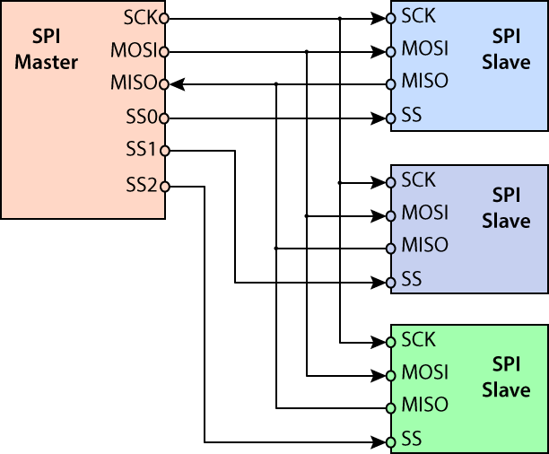

Slide 21

Note that MISO, MOSI, and SCK are available in a consistent physical location on the ICSP header; this is useful, for example, in designing a shield that works on every board.

Slide 22
SPI signals
In a full-blown SPI system you will have four signal lines:
Master Out, Slave In (MOSI) - which is the data going from the master to the slave
Master In, Slave Out (MISO) - which is the data going from the slave to the master
Serial Clock (SCK) - when this toggles both the master and the slave sample the next bit
Slave Select (SS) - this tells a particular slave to go "active"
When multiple slaves are connected to the MISO signal they are expected to tri-state (keep at high impedance) that MISO line until they are selected by Slave Select being asserted. Normally Slave Select (SS) goes low to assert it. That is, it is active low. Once a particular slave is selected it should configure the MISO line as an output so it can send data to the master.

Slide 23
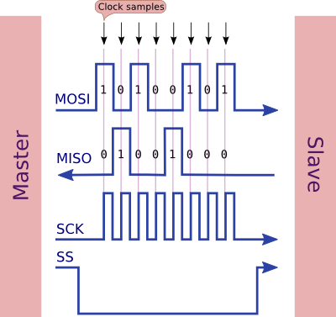

Slide 24
Timing
The sequence of events is:
SS goes low to assert it and activate the slave
The SCK line toggles to indicate when the data lines should be sampled
The data is sampled by both master and slave on the leading edge of SCK (using the default clock phase)
Both master and slave prepare for the next bit on the trailing edge of SCK (using the default clock phase), by changing MISO / MOSI if necessary
Once the transmission is over (possibly after multiple bytes have been sent) then SS goes high to de-assert it
Note that:
The most significant bit is sent first (by default)
Data is sent and received at the same instant (full duplex)
Because data is sent and received on the same clock pulse it is not possible for the slave to respond to the master immediately. SPI protocols usually expect the master to request data on one transmission, and get a response on a subsequent one.

Slide 25
Example of sending only (ignoring any incoming data):
#include <SPI.h>
void setup (void)
{
digitalWrite(SS, HIGH); // ensure SS stays high
SPI.begin ();
} // end of setup
void loop (void)
{
byte c; // enable Slave Select
digitalWrite(SS, LOW); // SS is pin 10
// send test string
for (const char * p = "Fab" ; c = *p; p++)
SPI.transfer (c); // disable Slave Select
digitalWrite(SS, HIGH);
delay (100);
} // end of loop

Slide 26
Clock phase and polarity
There are four way you can sample the SPI clock.
The SPI protocol allows for variations on the polarity of the clock pulses. CPOL is clock polarity, and CPHA is clock phase.
Mode 0 (the default) - clock is normally low (CPOL = 0), and the data is sampled on the transition from low to high (leading edge) (CPHA = 0)
Mode 1 - clock is normally low (CPOL = 0), and the data is sampled on the transition from high to low (trailing edge) (CPHA = 1)
Mode 2 - clock is normally high (CPOL = 1), and the data is sampled on the transition from high to low (leading edge) (CPHA = 0)
Mode 3 - clock is normally high (CPOL = 1), and the data is sampled on the transition from low to high (trailing edge) (CPHA = 1)

Slide 27
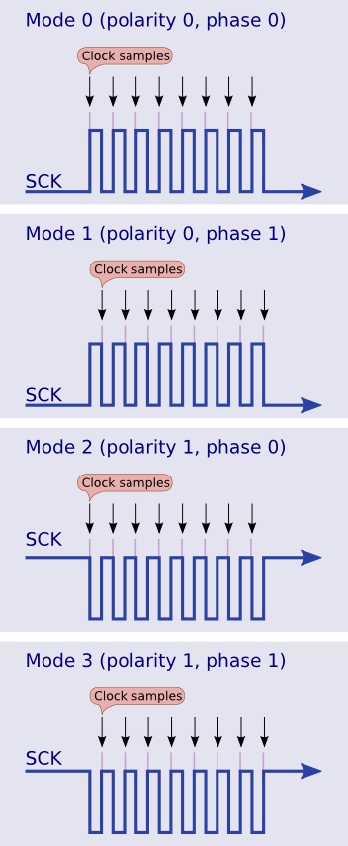

Slide 28

As you can see the clock is normally low (CPOL = 0) and it is sampled on the leading edge (CPHA = 0) so this therefore is SPI mode 0.

Slide 29
You can change the clock polarity and phase in code like this (choose one only, of course):
SPI.setDataMode (SPI_MODE0);
SPI.setDataMode (SPI_MODE1);
SPI.setDataMode (SPI_MODE2);
SPI.setDataMode (SPI_MODE3);
This method is deprecated in versions 1.6.0 onwards of the Arduino IDE. For recent versions you change the clock mode in the SPI.beginTransaction call, like this:
SPI.beginTransaction (SPISettings (2000000, MSBFIRST, SPI_MODE0)); // 2 MHz clock, MSB first, mode 0

Slide 30
Protocols
The SPI spec does not specify protocols as such, so it is up to individual master/slave pairings to agree on what the data means. Whilst you can send and receive bytes simultaneously, the received byte cannot be a direct response to the sent byte (as they are being assembled simultaneously).
So it would be more logical for one end to send a request and then do transfers (perhaps just sending zeros outwards) until it receives a complete response. The response might terminate with a newline, or 0x00 character.

Slide 31
How to make an SPI slave
The earlier example shows the Arduino as the master, sending data to a slave device. This example shows how the Arduino can be a slave.
Hardware setup
Connect two Arduino Unos together with the following pins connected to each other:
10 (SS)
11 (MOSI)
12 (MISO)
13 (SCK)
+5v (if required)
GND (for signal return)
On the Arduino Mega, the pins are 50 (MISO), 51 (MOSI), 52 (SCK), and 53 (SS).
In any case, MOSI at one end is connected to MOSI at the other, you don't swap them around (that is you do not have MOSI <-> MISO). The software configures one end of MOSI (master end) as an output, and the other end (slave end) as an input.

Slide 32
Master example
#include <SPI.h>
void setup (void)
{
digitalWrite(SS, HIGH); // ensure SS stays high for now
SPI.begin (); // Slow down the master a bit SPI.setClockDivider(SPI_CLOCK_DIV8);
} // end of setup
void loop (void)
{
char c; // enable Slave Select
digitalWrite(SS, LOW); // SS is pin 10
// send test string
for (const char * p = "Hello, world!\n" ; c = *p; p++)
SPI.transfer (c);
// disable Slave Select
digitalWrite(SS, HIGH);
delay (1000); // 1 seconds delay
} // end of loop

Slide 33
#include <SPI.h>
char buf [100];
volatile byte pos;
volatile bool process_it;
void setup (void)
{
Serial.begin (115200); // debugging
// turn on SPI in slave mode
SPCR |= bit (SPE);
// have to send on master in, *slave out*
pinMode (MISO, OUTPUT); // get ready for an interrupt
pos = 0; // buffer empty
process_it = false;
// now turn on interrupts
SPI.attachInterrupt();
} // end of setup

Slide 34
// SPI interrupt routine
ISR (SPI_STC_vect)
{ byte c = SPDR; // grab byte from SPI Data Register
// add to buffer if room
if (pos < sizeof buf)
{
buf [pos++] = c;
// example: newline means time to process buffer
if (c == '\n')
process_it = true;
} // end of room available
} // end of interrupt routine SPI_STC_vect
// main loop - wait for flag set in interrupt routine
void loop (void)
{
if (process_it)
{
buf [pos] = 0;
Serial.println (buf);
pos = 0;
process_it = false;
} // end of flag set
} // end of loop

Slide 35
The slave is entirely interrupt-driven, thus it can doing other stuff. The incoming SPI data is collected in a buffer, and a flag set when a "significant byte" (in this case a newline) arrives. This tells the slave to get on and start processing the data.

